Slide 1
Urban Air-Quality and Health Impact Analysis
Project 1
Team 2 :(Aswin Balaji Thippa Ramesh, Abhilasha Singh, Lixing Pan)
IDS 6101

Slide 2

Purpose
Formulating SMART, research-driven questions
Conducting thorough Exploratory Data Analysis (EDA)
Applying relevant statistical tests
Presenting findings and conclusions

Slide 3
Smart Questions
Investigate the key meteorological factors that significantly influence health risk scores.
Analyze how key meteorological factors vary across different cities.
Examine how air quality and health risk scores vary over the month.
Assess how trends in air quality indicators and health risk scores differ between weekdays and weekends.
Does humidity levels and health risk scores prompt important inquiries into the potential effects of varying humidity on overall health.

Slide 4
Exploratory Data Analysis (EDA)
Understand the Dataset and its Structure
Categorizing Variables
Handling Missing Values
Detecting Outliers- Boxplot
Univariate Analysis-Histogram and Bar plots
Bivariate Analysis (Analyzing Two Variables Together)- Scatter plot
Multivariate Analysis (Analyzing More Than Two Variables)- correlation matrix heatmap

Slide 5
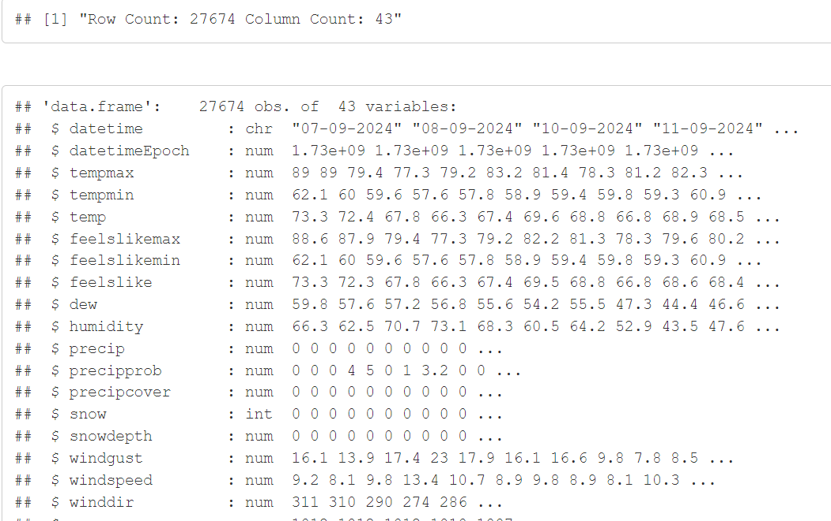
Exploratory Data Analysis (EDA)
Dataset Loading and Details
Insight: Collection of 27674 observations related to weather and its potential health impacts across major seven U.S. cities.

Slide 6
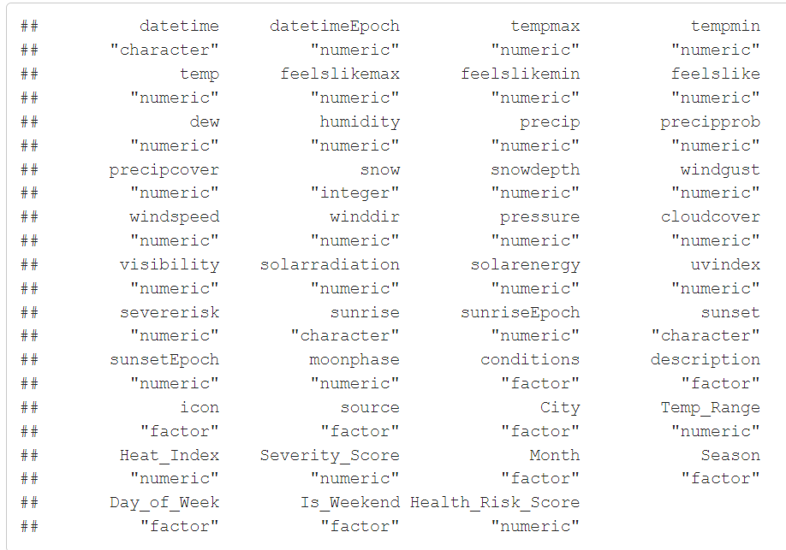
Exploratory Data Analysis (EDA)
Appropriate Datatype Conversion
Insight: Out of 43 variables, 9 variables are factor, 30 are numeric, and 3 are character.

Slide 7
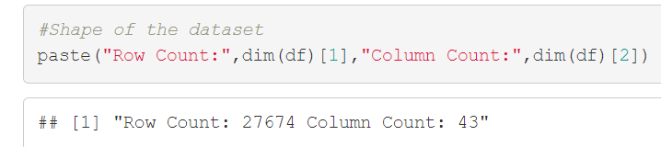
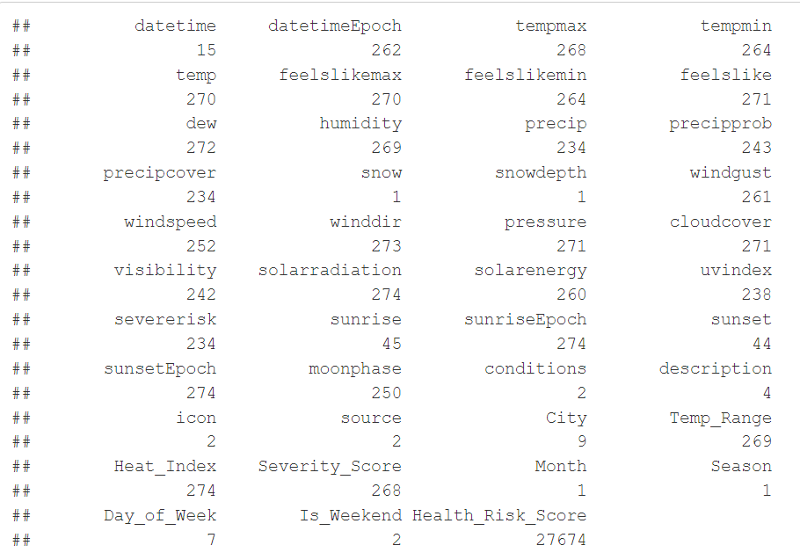
Exploratory Data Analysis (EDA)
Dropping Unwanted Column
Insight: Dropping season , snow, snowdepth and month columns as they have single value.

Slide 8
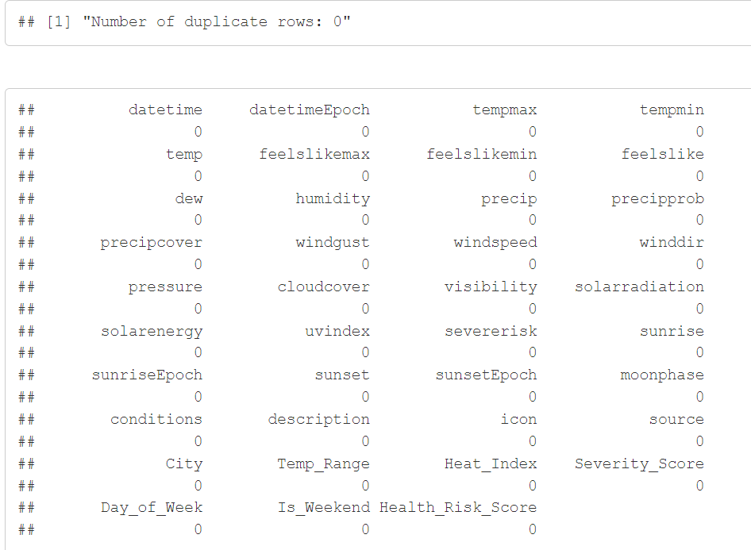
Exploratory Data Analysis (EDA)
Missing values
And duplicate rows
Insight: No missing values and duplicate rows

Slide 9
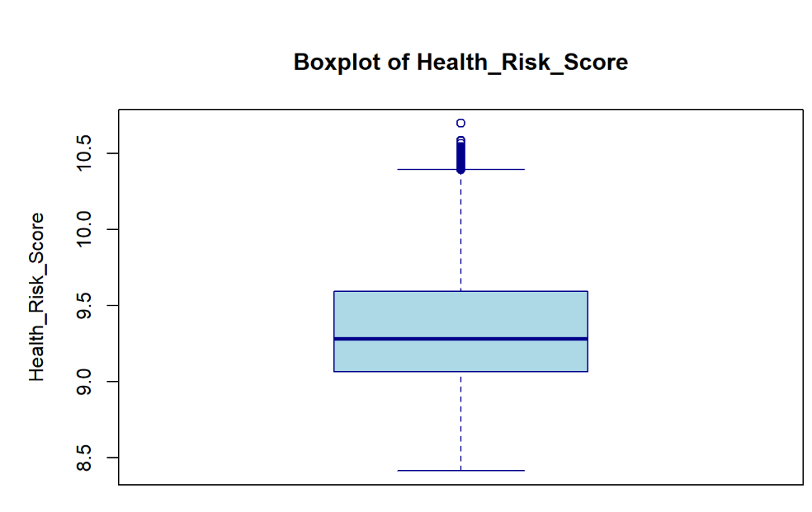
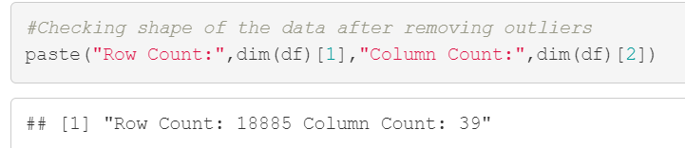
Exploratory Data Analysis (EDA)
Removing Outliers
Insight: After removing the outliers, we are left with 18885 observations

Slide 10
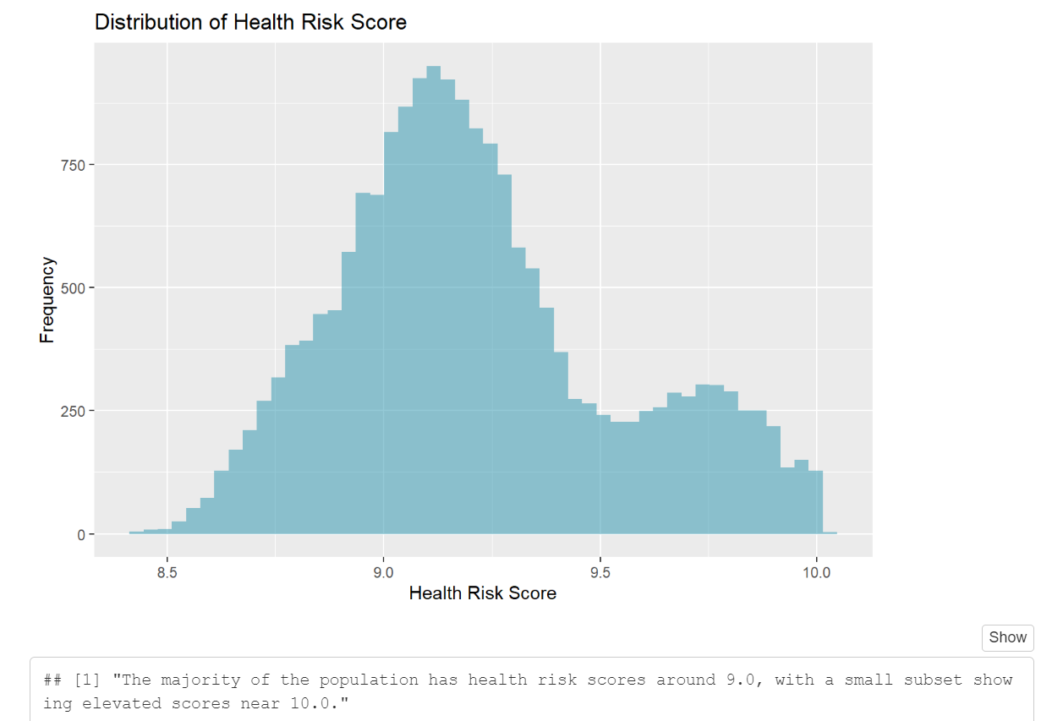
Exploratory Data Analysis (EDA)
Univariate Analysis
Insight: Most of the population has health risk scores around 9.0, with a small subset showing elevated scores near 10.0.

Slide 11
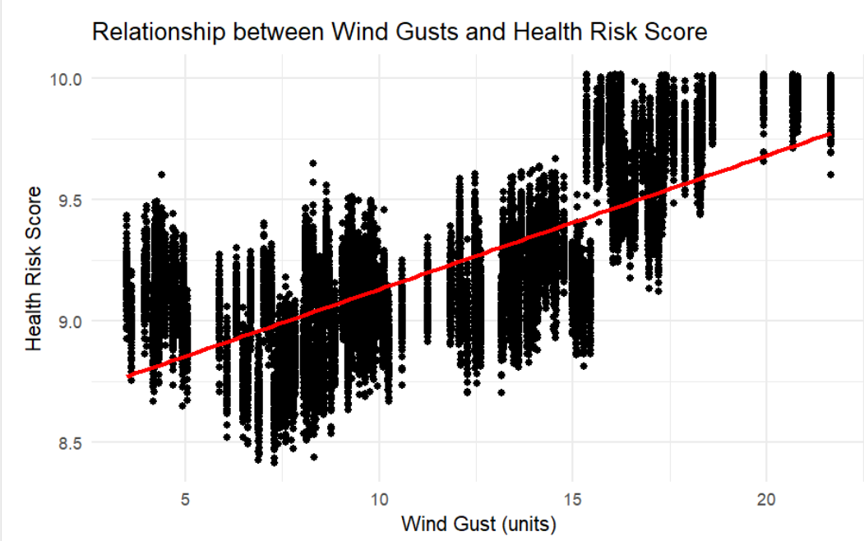
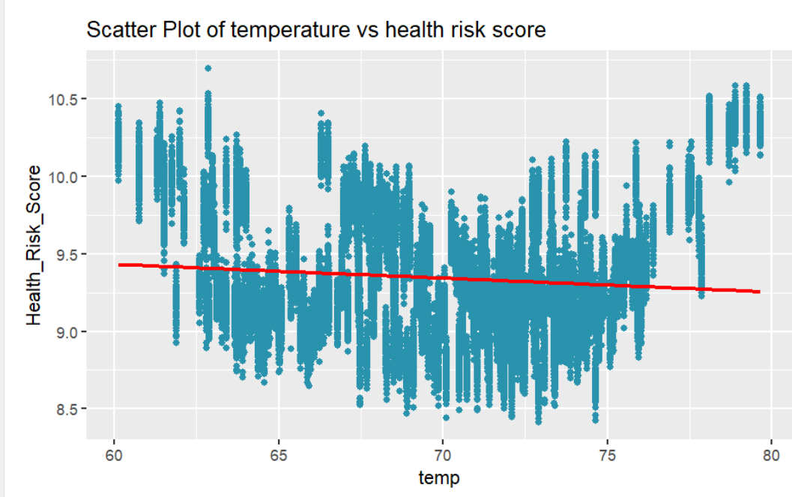
Exploratory Data Analysis (EDA)
1. Investigating the key meteorological factors that significantly influence health risk scores?
Insight:

Slide 12
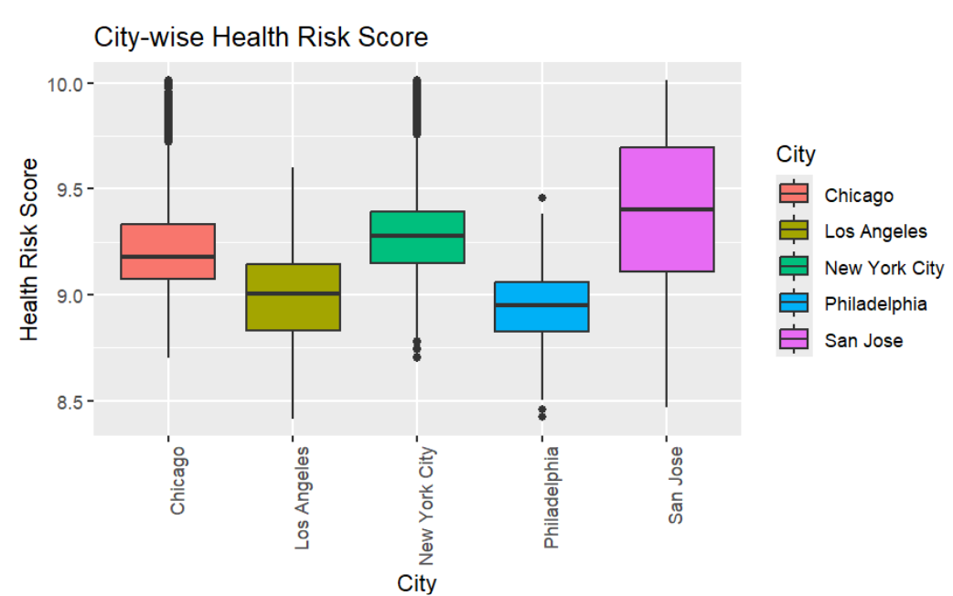
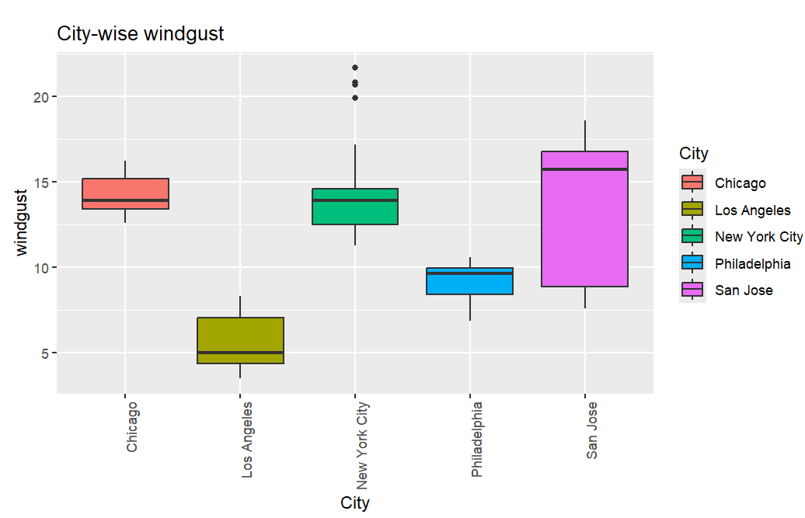
Exploratory Data Analysis (EDA)
2. Analyzing how key meteorological factors vary across different cities.
Insight:

Slide 13
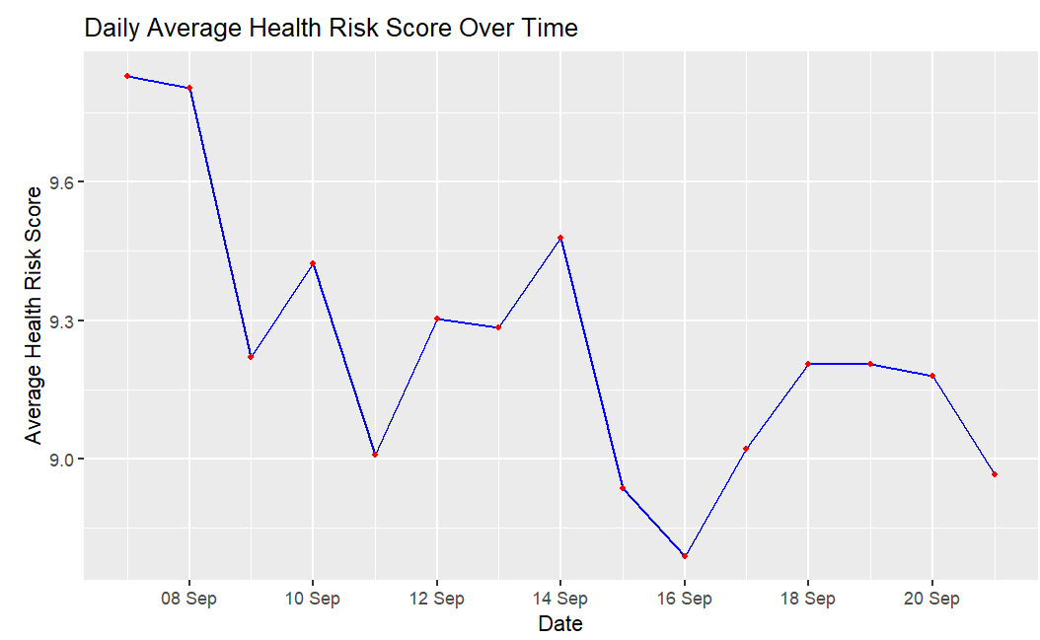
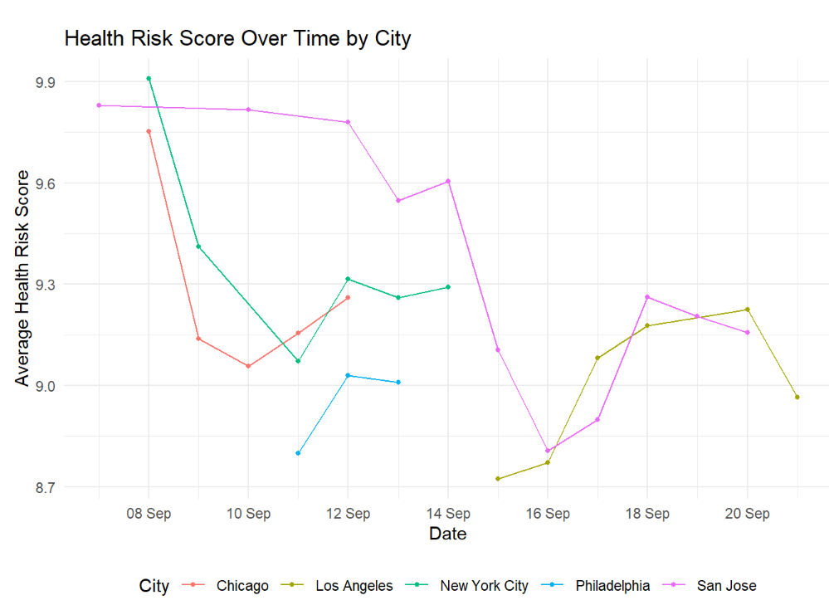
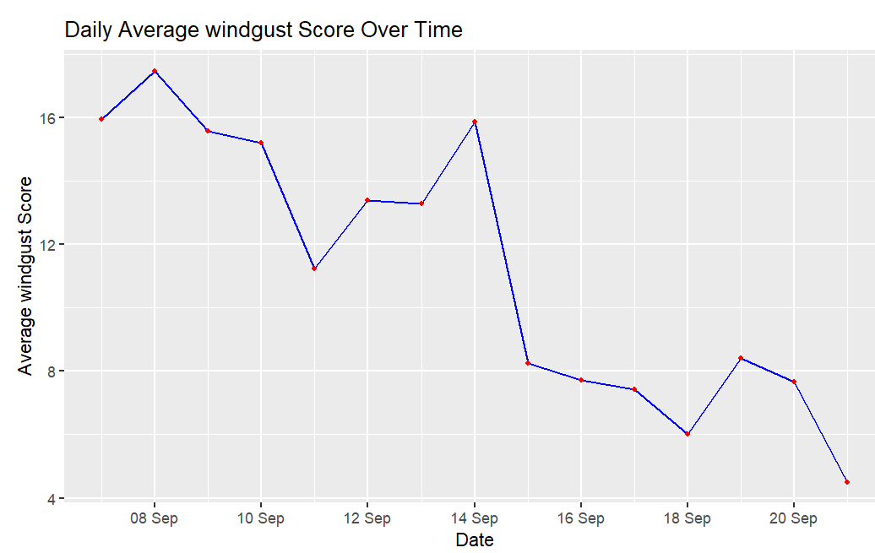
Exploratory Data Analysis (EDA)
3. Examine how air quality and health risk scores vary over the month.
Insight:

Slide 14
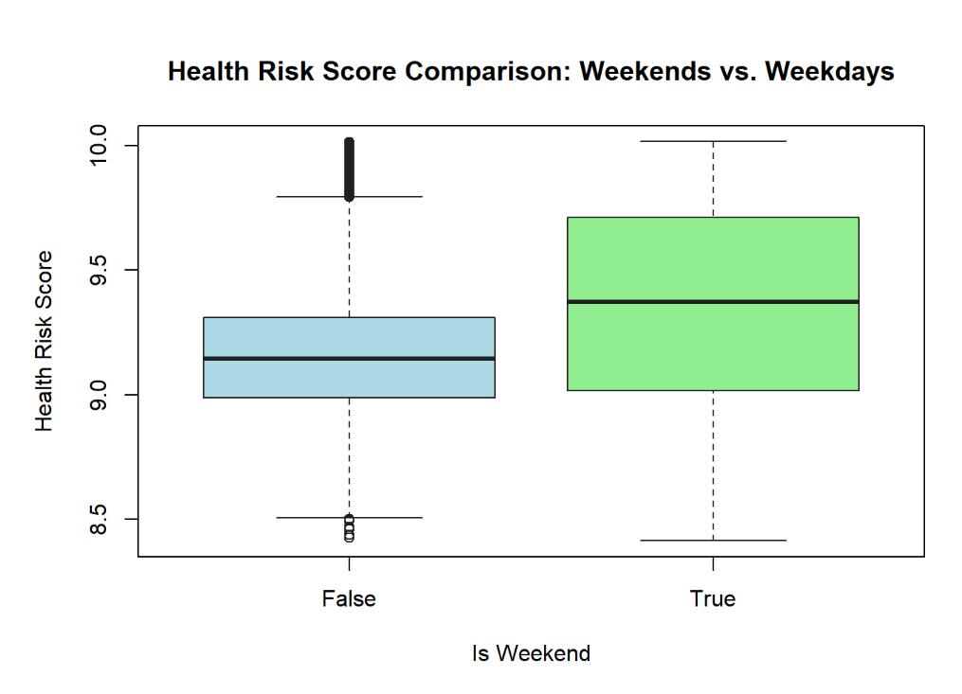
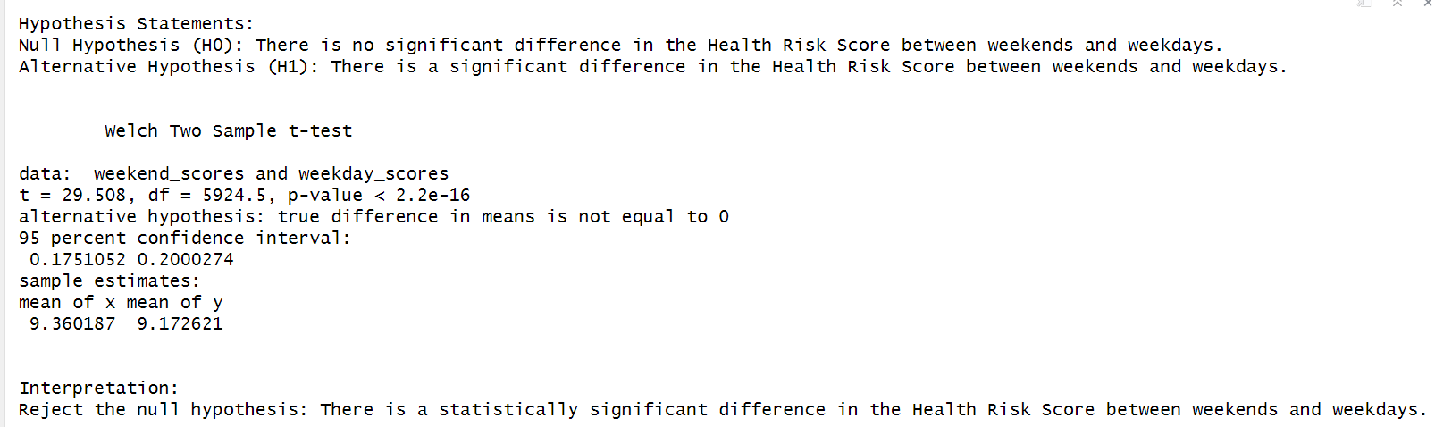
Exploratory Data Analysis (EDA)
4. Assess how trends in air quality indicators and health risk scores differ between weekdays and weekends.
Insight:

Slide 15
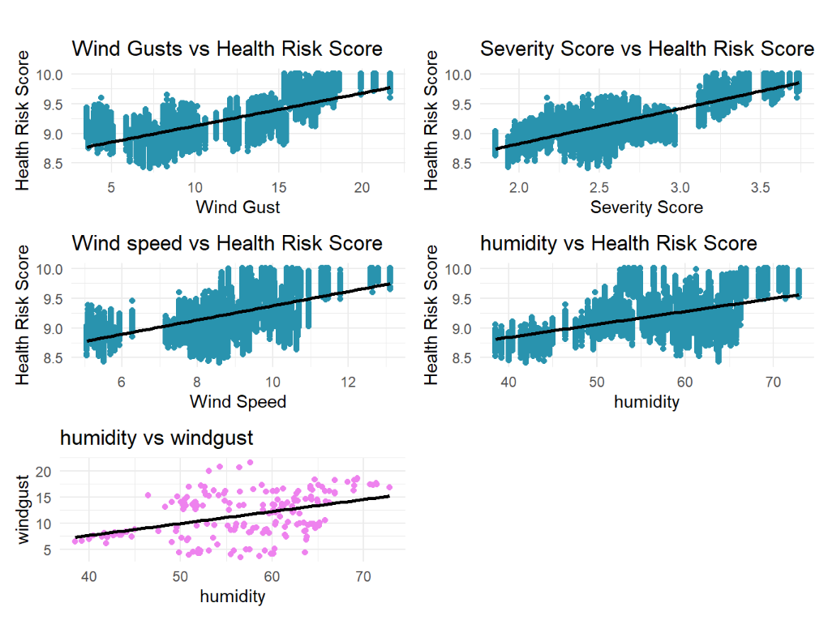
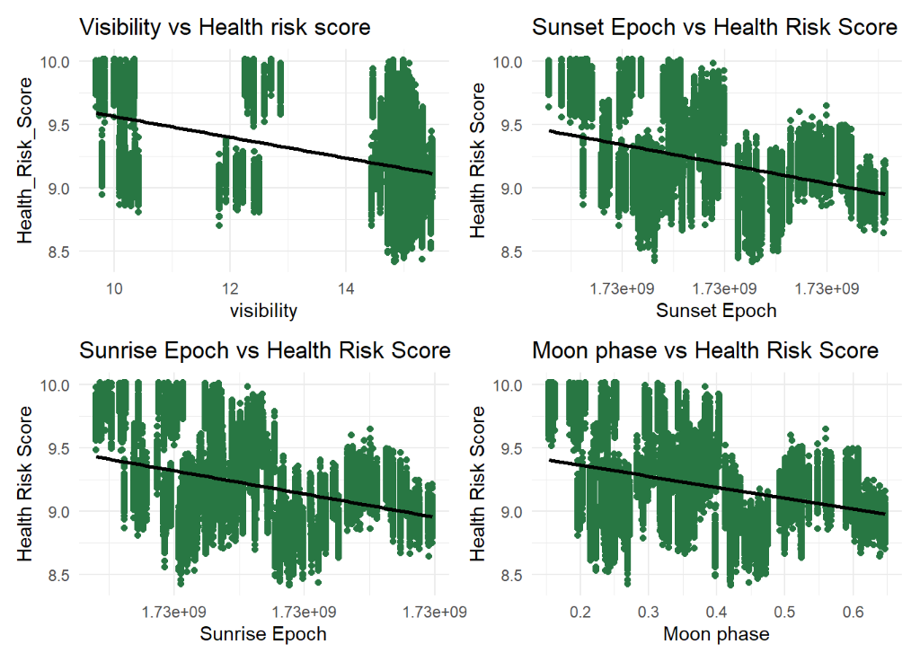
Exploratory Data Analysis (EDA)
5. Does humidity levels and health risk scores prompt important inquiries into the potential effects of varying humidity on overall health.?
Insight:

Slide 16
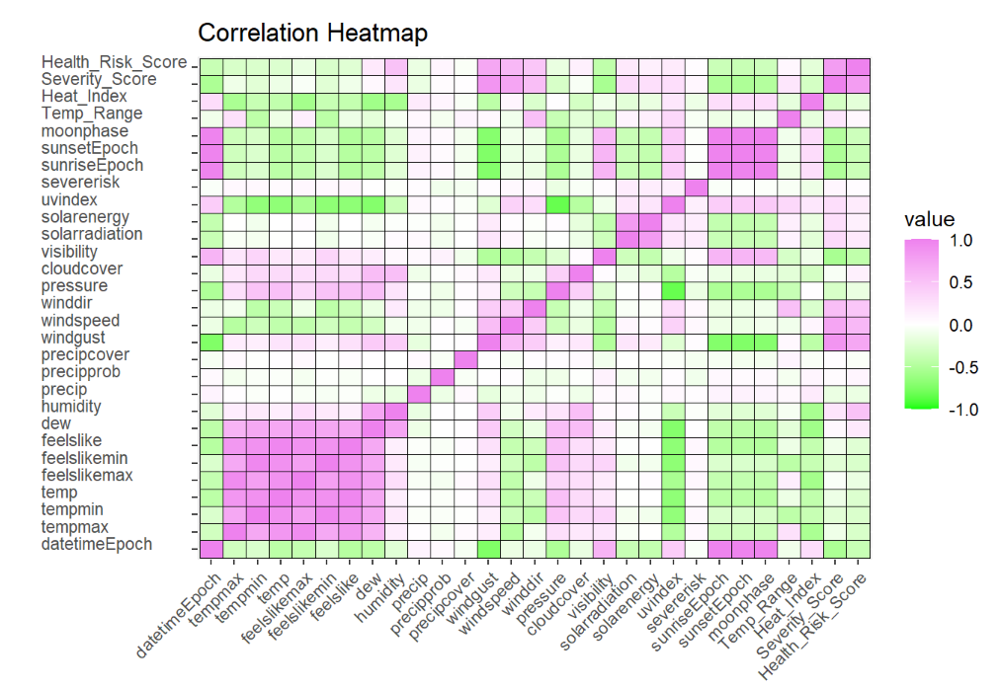
Exploratory Data Analysis (EDA)
Correlation heatmap
Insight:

Slide 17
Conclusion

Slide 18

Any thoughts or questions?

Slide 19

Thank you!

